Slide 1
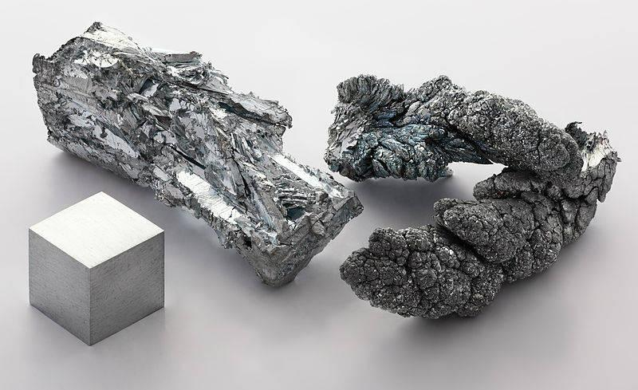
Metallic Bonding & Structure
Unit 2
Lesson 8

Slide 2
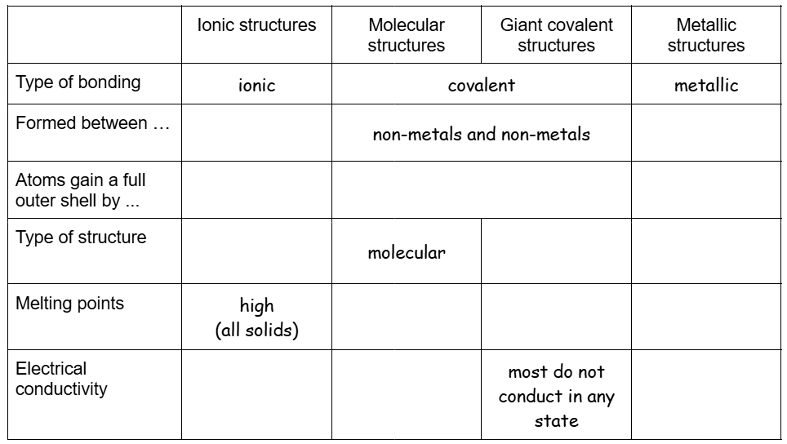
Starter: fill in the first three columns on page ??

Slide 3
Today’s Aim
Unit 2
Lesson 8
By the end of this lesson I will be able to describe the structures of metals and use this to explain metallic properties

Slide 4
Mini-whiteboards
Write down as many properties of metals that you can...
high melting and boiling points (which means they tend to be solid at room temperature)
good conductors of electricity
good conductors of heat
malleable
ductile
usually strong/hard
usually dense
lustrous (shiny) and sonorous (make a ringing sound)
Notes:
The last two properties (lustrous and sonorous) are not important for GCSE chemistry.

Slide 5
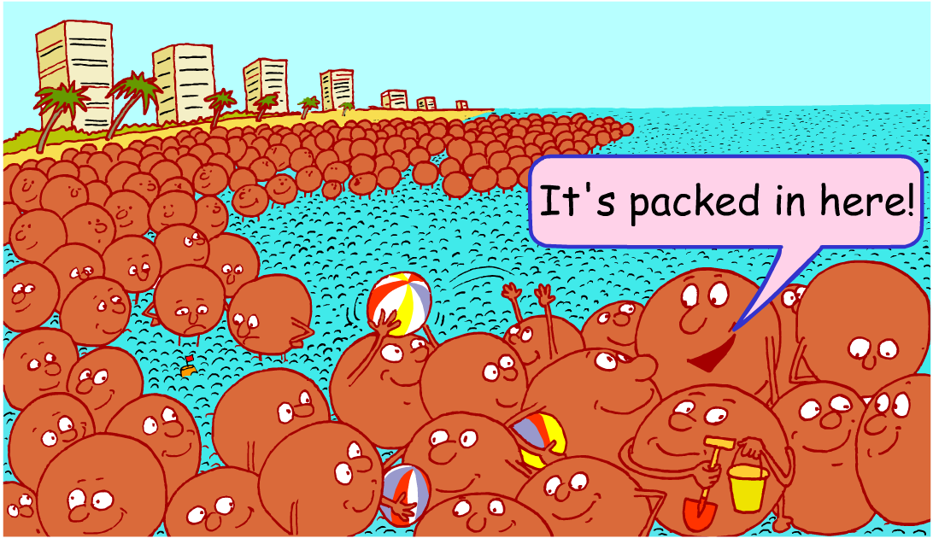
Why do metals have these properties?
Notes:
This illustration represents some key features of metallic bonding including:
The metal ions (represented by the brown spherical characters) are standing very close together. This can be used to remind students of the tightly-packed arrangement of ions that occurs in metallic structures. It could also be mentioned that the metal ions are in a happy, holiday mood: they are positive ions.
The metal ions are surrounded by sea. This represents the sea of electrons found in metallic bonding. Students should be aware that it is the strong attraction between the positively charged ions and the negatively charged sea of electrons that gives metals their properties of strength and high melting and boiling points. The sea of electrons is also able to move freely around the closely packed metal ions. This enables metals to conduct heat and electricity.

Slide 6

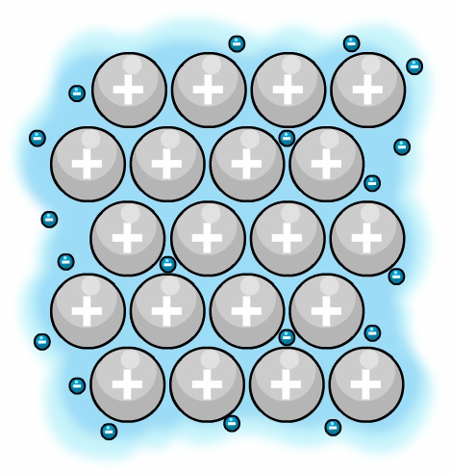
Metallic Bonding
sea of electrons
A pure metal is made up of tightly-packed layers, which form a regular lattice structure.
The outer electrons of the metal atoms separate and create a ‘sea of electrons’ surrounding the metal ions.
These electrons are delocalised and so are free to move through
the whole structure.
metal ions
Notes:
NB: this diagram is not drawn to scale - an electron is tiny compared to a metal ion, especially the solid nucleus of a metal ion. This means that the electrons are able to pass between the metal ions.

Slide 7
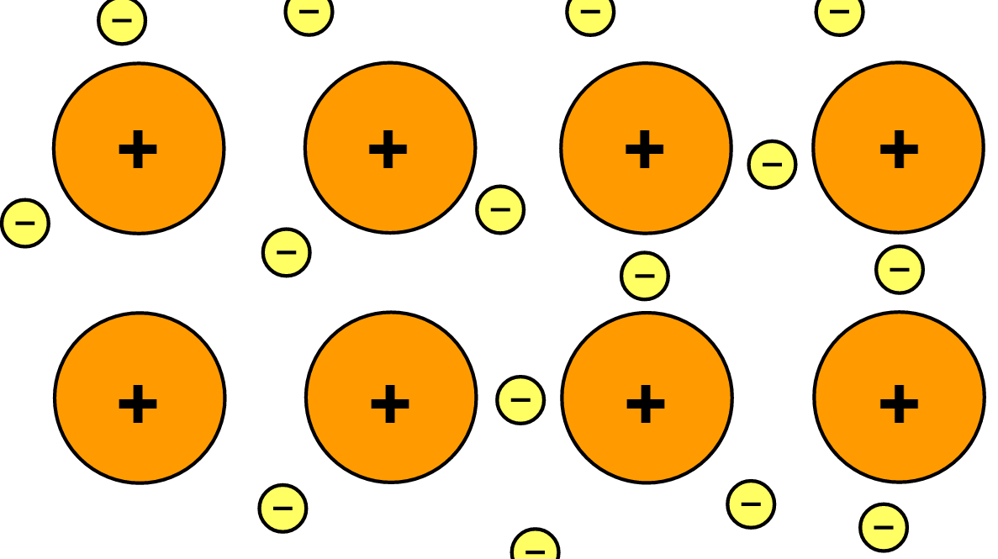
Metallic structures
Cu²⁺
The outer electrons of the metal atoms are delocalised creating a ‘sea of negative electrons’. The metal atoms become positively charged ions.
There is a strong electrostatic attraction between the negative sea of electrons and positive metal ions. This attraction in all directions is called metallic bonding.
Notes:
NB: this diagram is not drawn to scale - an electron is tiny compared to a metal ion. This means that the electrons are able to easily pass between the metal ions.

Slide 8
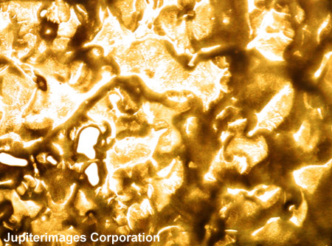
Reasons for high melting points
Metals often have high melting points (for example: gold has a melting point of 1064°C and a boiling point of 2807°C).
The reason metals have high melting points is due to the strong electrostatic attraction between the positively-charged metal ions and the sea of electrons.
A lot of energy is needed to overcome these forces of attraction.
Liquid Gold .
Notes:
Molten gold.

Slide 9
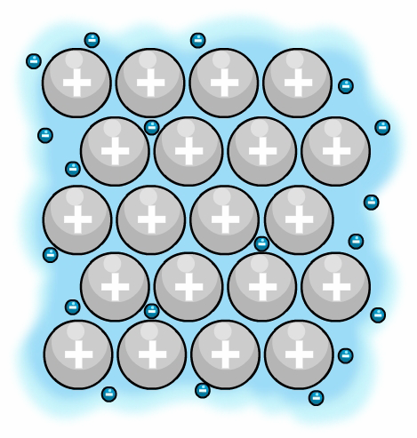
Reasons for conducting heat
Delocalised electrons in metallic bonding allow metals to conduct heat.
For example, when a metal is heated, the delocalised electrons gain kinetic energy.
These electrons then move faster and so transfer the gained energy throughout the metal.
This means metals are good conductors of heat.
heat

Slide 10
Reasons for electrical conductivity
Metals are also good conductors of electricity as the delocalised electrons are free to move.
Electrons can carry charge and this flow of charge is called electricity.
Metal ions that donate more electrons to the ‘sea’ are better conductors than those that donate less.

Slide 11
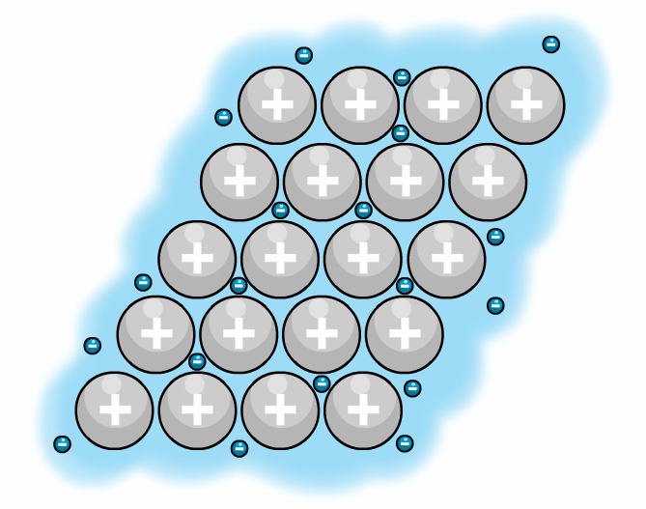
Reasons for metals being ductile
Metals are usually strong, not brittle. When a metal is hit, the layers of metal ions are able to slide over each other, and so the structure does not shatter.
metal before it is hit
metal after it is hit
force
force
The metallic bonds do not break because the delocalised electrons are free to move throughout the structure. This explains why metals are malleable (easy to shape) and ductile (can be drawn into wires).

Slide 12
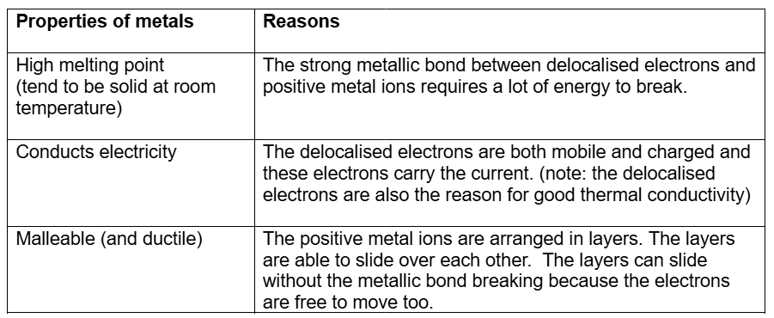
Summary of the properties of metals - page ??

Slide 13
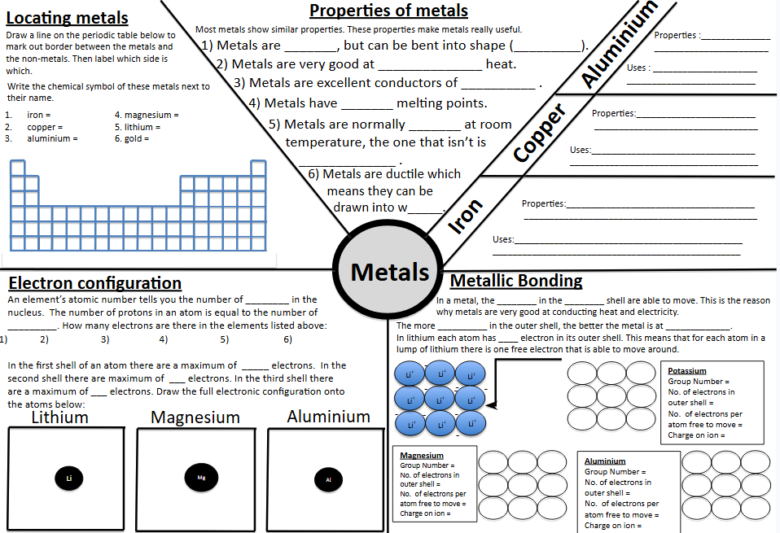
Complete this sheet on page ??

Slide 14
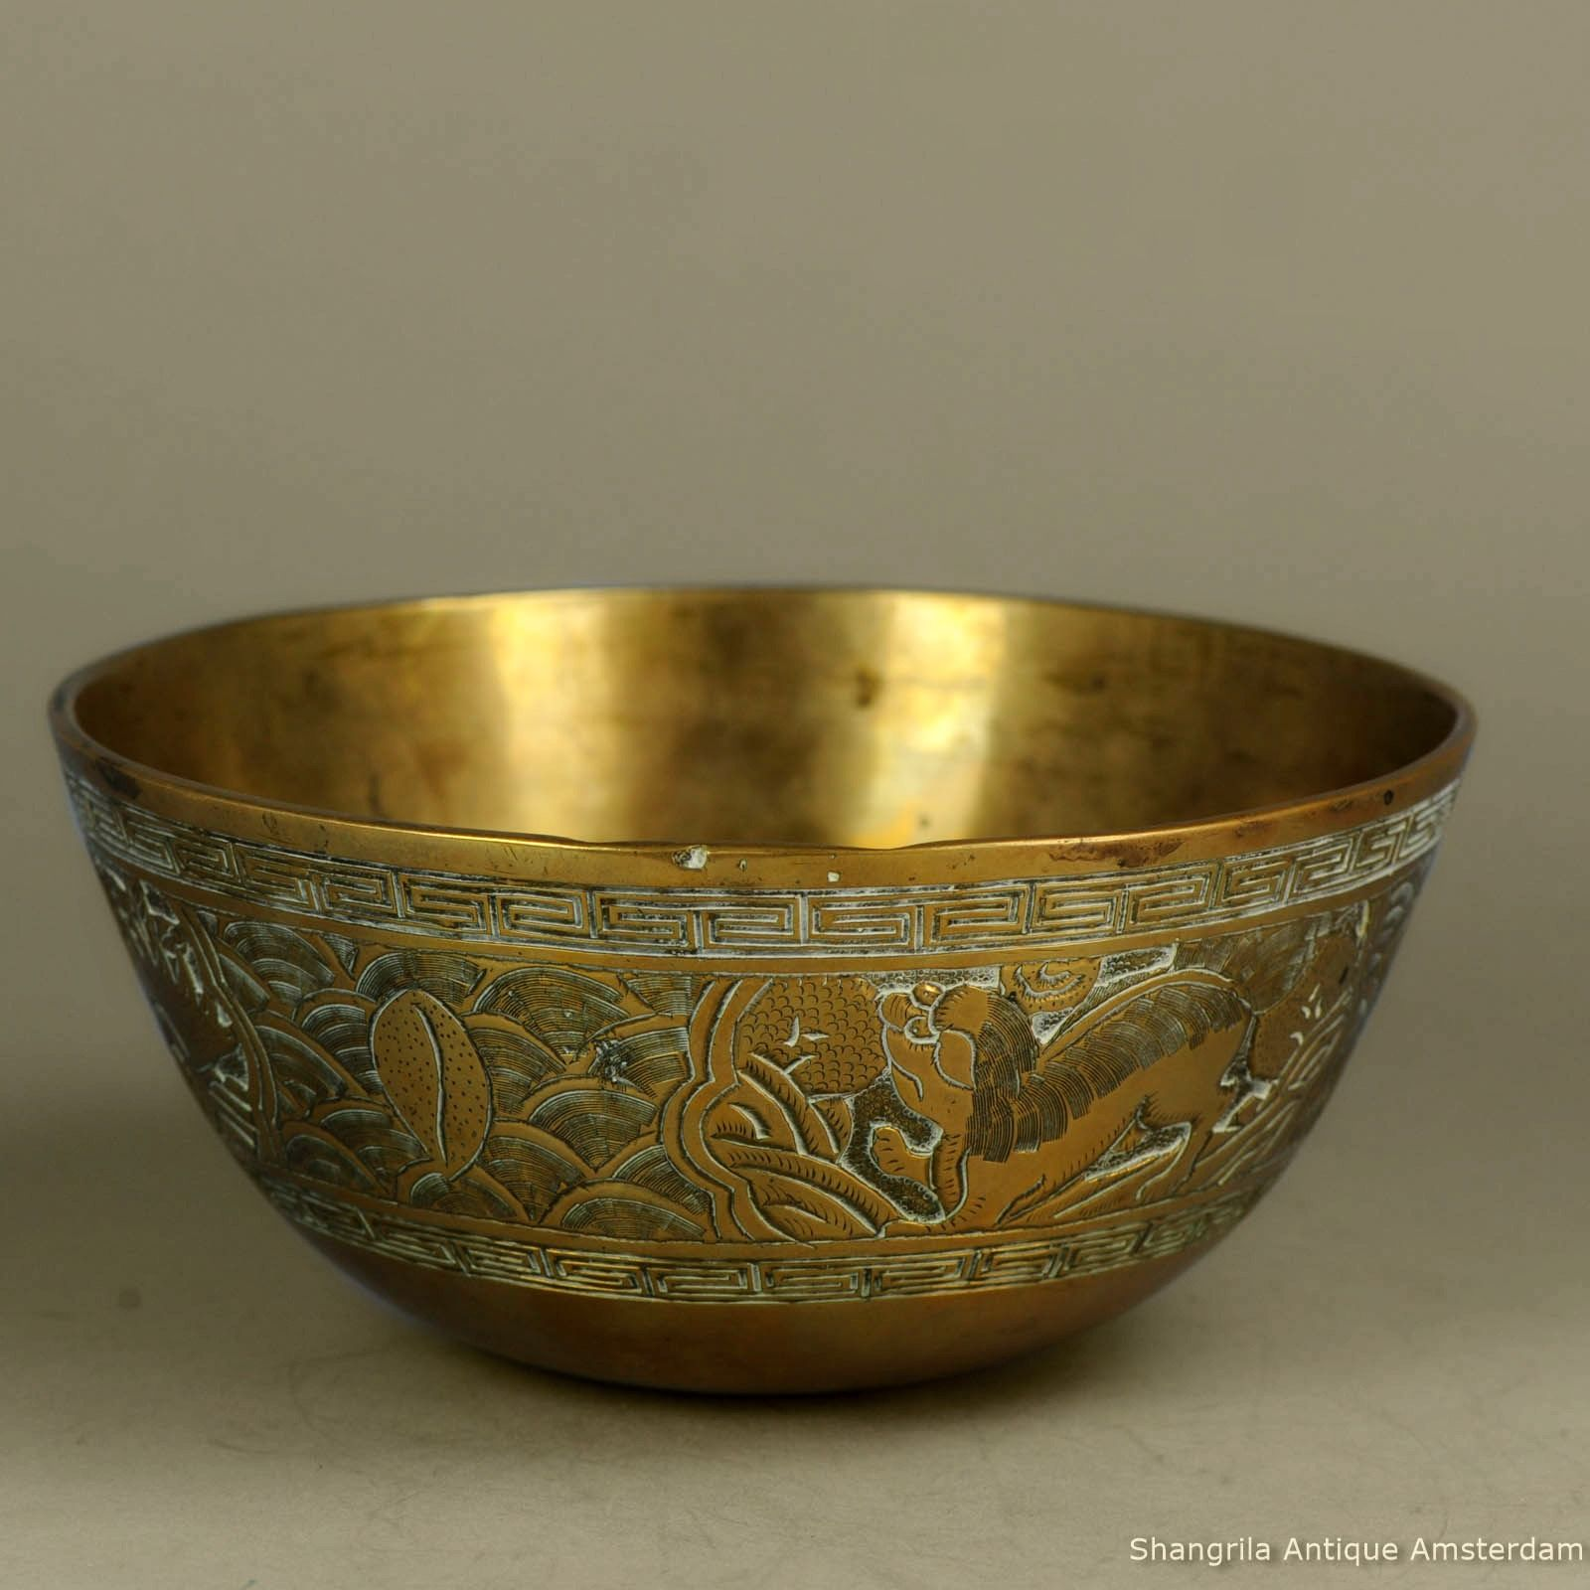
Plenary: multiple choice question
Copper is malleable. This antique Chinese copper bowl has been hammered into shape. Select the statement that best explains this property.
A copper atoms are soft and can be easily squashed.
B there are no forces of attraction between the copper atoms.
C the copper atoms can be made to slide across each other.
D copper atoms can be flattened if hit hard enough.

Slide 15

What you need to know
Unit 2
Lesson 8
What you should know:
explain typical physical properties of metals, including density, electrical conductivity and malleability.
My Learning

